Slide 1
定例
NAWI
熊谷 渉
MK本部 イノベーションセンター
プロジェクトデザイン部 オペレーショナルエクセレンスGr.
2024年1月31日

Slide 2
概要
個人目的
Task2を見据えた最適化システム構成案を検討する。
今週進捗
最適化システム構成については進捗なし。
長期最適化のための予測方法を検討し始めた。トライアルしたが、ハイパーパラメータチューニングしないと公平に評価できないと考えられる。
⇒これを今回は報告
来週目標
ハイパラチューニング付きの評価・比較。

Slide 3

モデリング・最適化ソルバの対応関係
1. 最適化方法
実行手順
Operation Schedule
Preprocessing
Modeling
Optimization
Model File Storage
Model File
Model File
モデリング手法は3種類用意している
最適化手法は2種類用意している
今回は使用したモデルの種類に応じて、ソルバを切り替わるようにした
1. 線形重回帰（MLR）
線形ソルバ（python Pulp）
⇒線形
⇒線形だけ解けるが、厳密解を得られる
2. 偏最小二乗回帰（PLS）
前回まではモデルに問わず、一つの方法で解いていた
⇒線形
2. メタヒューリスティクス＋制約対処法
(スクラッチ)
3. Random Forest
今回の想定
⇒非線形（ブラックボックス）、
線形でも適用できるが、近似解しか得られない
⇒非線形（ブラックボックス）
モデリングを実行したとき、モデルファイルと、モデリングの種類を書き出したテキストファイルを保存しておき、最適化でそれらを読み込む形にした
Notes:
There are two steps. First step is RO modeling. In step1, get the operation data from DB and preprocess data. And, build RO model using operation data and setting file. After that, show the model accuracy or prediction trend chart on the dashboard for the operator and save model file to some storage or database. Second step is RO optimization. In step2, get the operation data from DB and preprocess data. And, get the RO model file from storage. Next, calculate optimization using operation data, setting file, and RO model file. After that, show the operation schedule on the dashboard for the operator. To carry out this process, we are looking into the possibility of developing ROCO system at XRAI platform.

Slide 4
長期最適化のための方針
1. 最適化方法
1. Random Forestよりも計算量が軽く、同等の予測精度が得られる予測方法があるのか検証する。
候補として回帰木モデルの改良が期待されるが、RFとの厳密な比較は調査していない
2. 評価回数を削減するように、最適化方法を工夫する。
逐次近似最適化
備考
想定する予測期間の最長（何step、何か月）は？膜の詰まりを想定するなら数か月先か？
汎用的な計算方法として検証するために、プラントデータではなく、サンプルデータを使用する予定
本来は、最適化用モデル（特性抽出）として使う点も考慮すべきだが、今回は除外
今回の報告
Notes:
There are two steps. First step is RO modeling. In step1, get the operation data from DB and preprocess data. And, build RO model using operation data and setting file. After that, show the model accuracy or prediction trend chart on the dashboard for the operator and save model file to some storage or database. Second step is RO optimization. In step2, get the operation data from DB and preprocess data. And, get the RO model file from storage. Next, calculate optimization using operation data, setting file, and RO model file. After that, show the operation schedule on the dashboard for the operator. To carry out this process, we are looking into the possibility of developing ROCO system at XRAI platform.

Slide 5
比較
2. 予測検証 > 条件
4つの手法同士で、計算時間や予測精度を比較する。
なお、計算時間は、学習時と予測時の両方を計測する
1度学習をした後、最適化時に予測計算を何度も繰り返すため、予測計算時間が重要
線形重回帰
RandomForest
LightGBM
LinearTree
Submodel=MLR
線形性
線形
非線形
非線形
非線形
透明性
White-box
Black-box
Black-box
White-box
計算量
軽
重
中
軽
Notes:
There are two steps. First step is RO modeling. In step1, get the operation data from DB and preprocess data. And, build RO model using operation data and setting file. After that, show the model accuracy or prediction trend chart on the dashboard for the operator and save model file to some storage or database. Second step is RO optimization. In step2, get the operation data from DB and preprocess data. And, get the RO model file from storage. Next, calculate optimization using operation data, setting file, and RO model file. After that, show the operation schedule on the dashboard for the operator. To carry out this process, we are looking into the possibility of developing ROCO system at XRAI platform.

Slide 6
検証パターン
2. 予測検証 > 条件
検証1：ベンチマークデータ（カリフォルニア住宅価格データセット）
相関があるデータでの検証、データ数と計算時間の関係
検証2：OCWDデータ、予測
想定しているデータでの検証
検証3：OCWDデータ、最適化
ハイパーパラメータはデフォルト値に設定。
今回の報告
社内業務用ノートPC（Intel Core i5-1145G7(2.60GHz)、内蔵GPU 11th Gen）
Notes:
There are two steps. First step is RO modeling. In step1, get the operation data from DB and preprocess data. And, build RO model using operation data and setting file. After that, show the model accuracy or prediction trend chart on the dashboard for the operator and save model file to some storage or database. Second step is RO optimization. In step2, get the operation data from DB and preprocess data. And, get the RO model file from storage. Next, calculate optimization using operation data, setting file, and RO model file. After that, show the operation schedule on the dashboard for the operator. To carry out this process, we are looking into the possibility of developing ROCO system at XRAI platform.

Slide 7
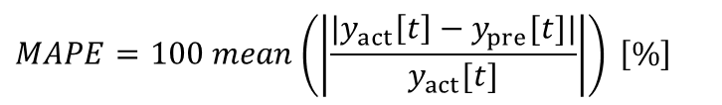
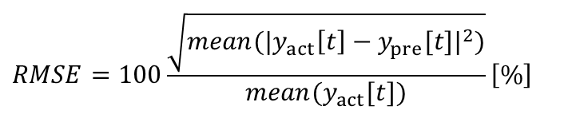
OCWD検証パターン
2. 最適化検証 > 条件
データ：1時間データにダウンサンプリング
期間：
学習期間：2022/04/26 0:00 – 2022/07/31 23:00（3か月、2208個）
予測期間：2022/08/01 0:00 – 2022/11/20 23:00（4か月、2688個）
検証パターン
相対誤差の平均
# | 予測値補正 | 予測対象
1 | 無し | 1st Permeate EC
2 | 有り | 1st Permeate EC
3 | 無し | Permeate TOC
4 | 有り | Permeate TOC
$$MAPE=100 mean\left(\left|\frac{|y_{act}\left[t\right]−y_{pre}[t]|}{y_{act}[t]}\right|\right) \left[\%\right]$$
絶対誤差平均が実績値に占める割合
$$RMSE=100\frac{\sqrt{mean({|y_{act}\left[t\right]−y_{pre}[t]|}^{2})}}{{mean(y}_{act}[t])}\left[\%\right]$$
※各予測モデルの説明変数群は、Task1と揃えた
Notes:
There are two steps. First step is RO modeling. In step1, get the operation data from DB and preprocess data. And, build RO model using operation data and setting file. After that, show the model accuracy or prediction trend chart on the dashboard for the operator and save model file to some storage or database. Second step is RO optimization. In step2, get the operation data from DB and preprocess data. And, get the RO model file from storage. Next, calculate optimization using operation data, setting file, and RO model file. After that, show the operation schedule on the dashboard for the operator. To carry out this process, we are looking into the possibility of developing ROCO system at XRAI platform.

Slide 8
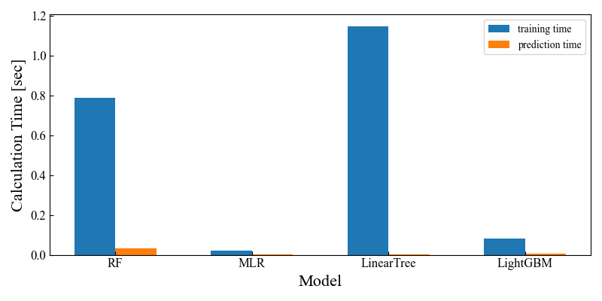
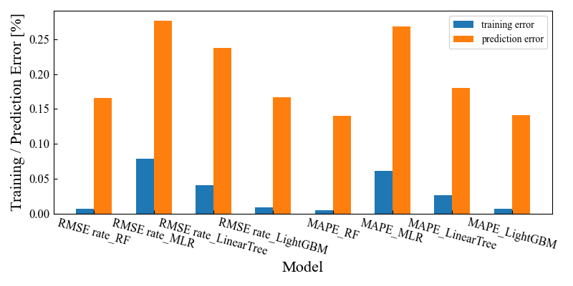
計算時間とモデル精度
2.1 予測結果 > 1st EC、予測値補正無
LightGBMは、予測時間が短く、汎化性能が良い（RFと同等）。
データの相関が低いため、区分線形は逆に外れやすくなったと考えられる
計算時間
モデル精度
0.79秒
1.15秒
0.002秒
0.08秒
0.03秒
0.02秒
0.004秒
0.004秒
学習データ数2,208個／予測データ数2,688個／説明変数8個
Notes:
There are two steps. First step is RO modeling. In step1, get the operation data from DB and preprocess data. And, build RO model using operation data and setting file. After that, show the model accuracy or prediction trend chart on the dashboard for the operator and save model file to some storage or database. Second step is RO optimization. In step2, get the operation data from DB and preprocess data. And, get the RO model file from storage. Next, calculate optimization using operation data, setting file, and RO model file. After that, show the operation schedule on the dashboard for the operator. To carry out this process, we are looking into the possibility of developing ROCO system at XRAI platform.

Slide 9
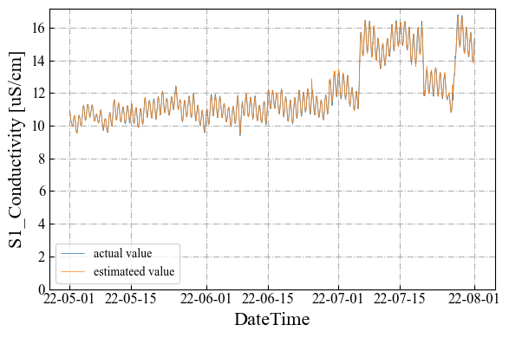
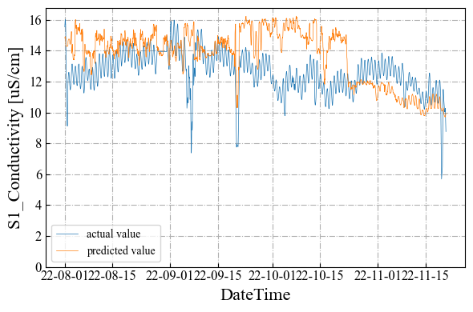
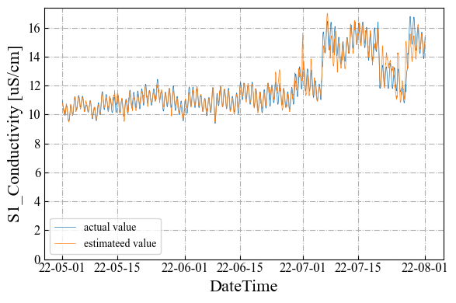
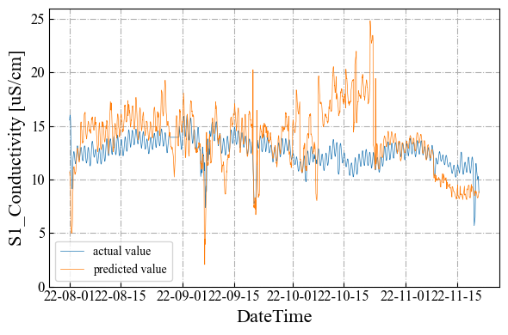
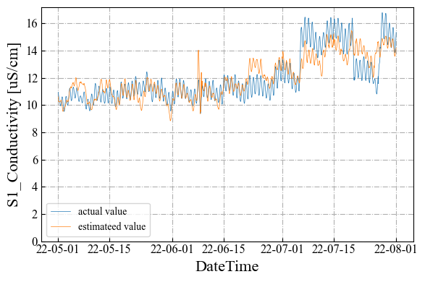
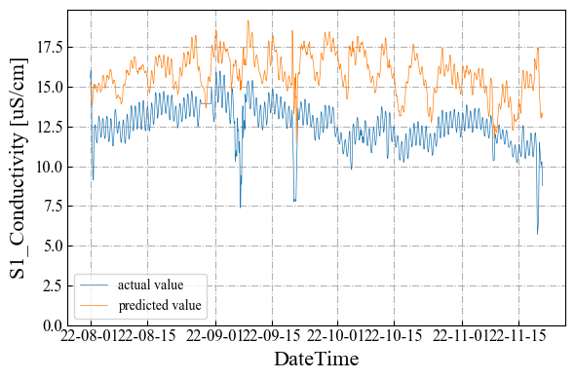
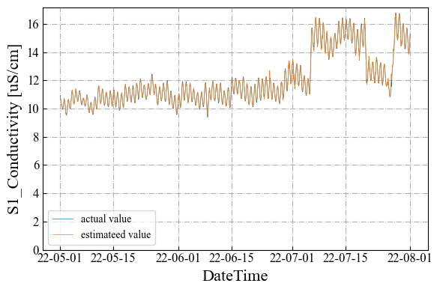
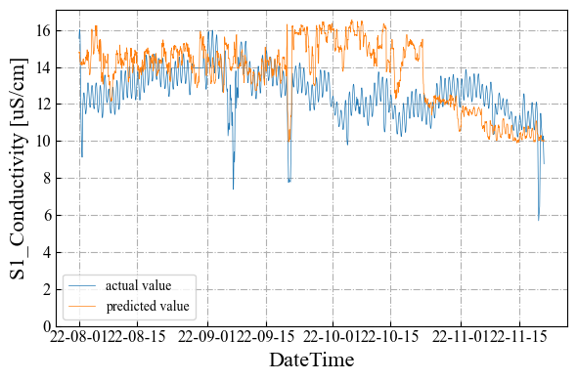
推定値／予測値トレンド
2.1 予測結果 > 1st EC、予測値補正無
推定
RandomForest
予測
推定
LinearTree
予測
推定
線形重回帰
予測
推定
LightGBM
予測
Notes:
There are two steps. First step is RO modeling. In step1, get the operation data from DB and preprocess data. And, build RO model using operation data and setting file. After that, show the model accuracy or prediction trend chart on the dashboard for the operator and save model file to some storage or database. Second step is RO optimization. In step2, get the operation data from DB and preprocess data. And, get the RO model file from storage. Next, calculate optimization using operation data, setting file, and RO model file. After that, show the operation schedule on the dashboard for the operator. To carry out this process, we are looking into the possibility of developing ROCO system at XRAI platform.

Slide 10
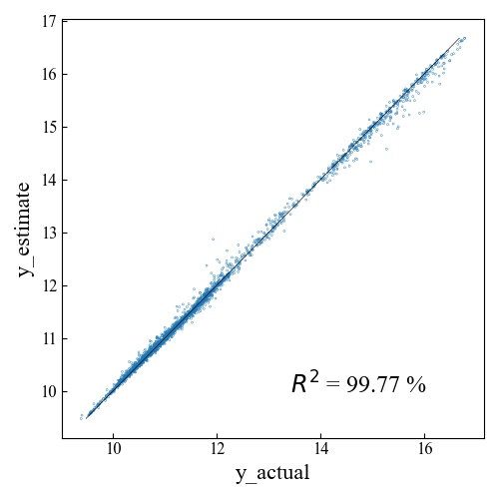
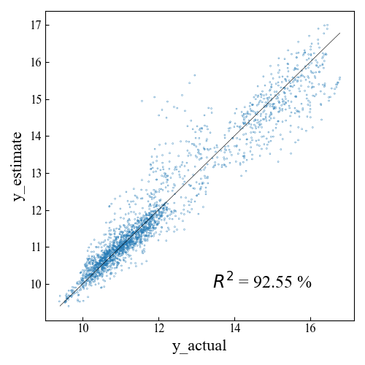
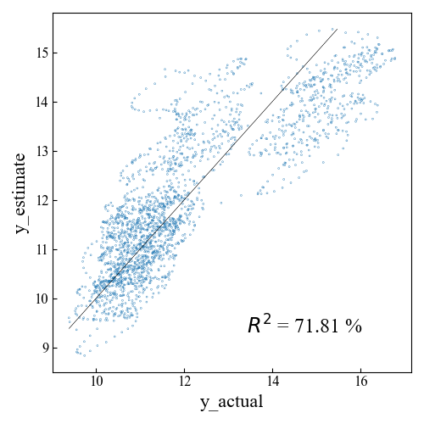
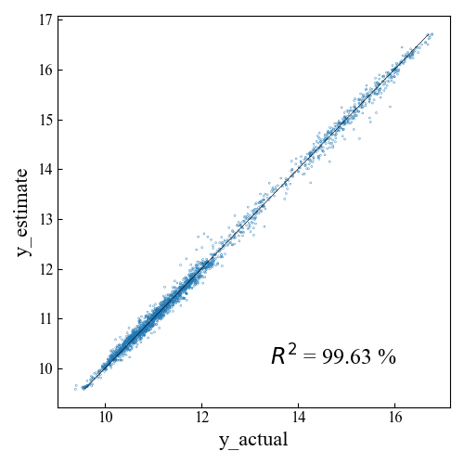
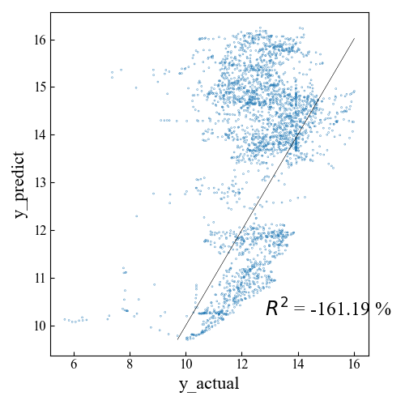
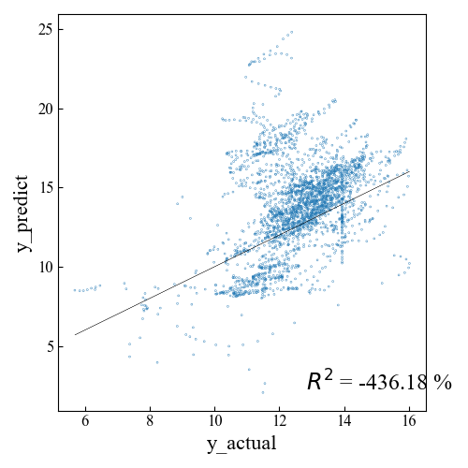
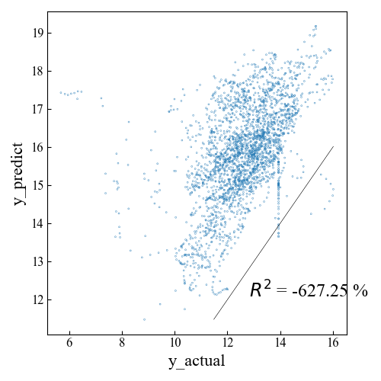
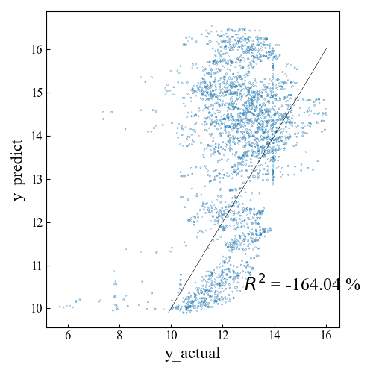
実績値 vs 計算値
2.1 予測結果 > 1st EC、予測値補正無
単位: uS/cm
RandomForest
LinearTree
線形重回帰
LightGBM
実績
vs
推定
データ数2,208個
実績
vs
予測
データ数2,688個
Notes:
There are two steps. First step is RO modeling. In step1, get the operation data from DB and preprocess data. And, build RO model using operation data and setting file. After that, show the model accuracy or prediction trend chart on the dashboard for the operator and save model file to some storage or database. Second step is RO optimization. In step2, get the operation data from DB and preprocess data. And, get the RO model file from storage. Next, calculate optimization using operation data, setting file, and RO model file. After that, show the operation schedule on the dashboard for the operator. To carry out this process, we are looking into the possibility of developing ROCO system at XRAI platform.

Slide 11
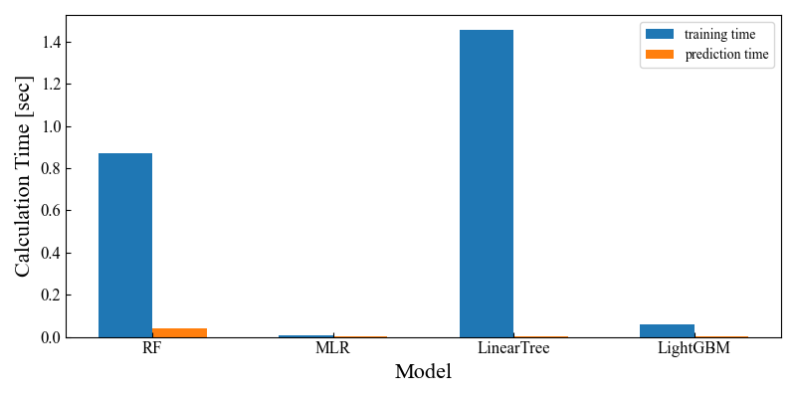

計算時間とモデル精度
2.2 予測結果 > 1st EC、予測値補正有
重回帰とLinearTreeの予測精度が改善するが、優劣関係は変わらない。
計算時間
モデル精度
0.87秒
1.45秒
0.002秒
0.06秒
0.04秒
0.008秒
0.004秒
0.003秒
学習データ数2,208個／予測データ数2,688個／説明変数8個
Notes:
There are two steps. First step is RO modeling. In step1, get the operation data from DB and preprocess data. And, build RO model using operation data and setting file. After that, show the model accuracy or prediction trend chart on the dashboard for the operator and save model file to some storage or database. Second step is RO optimization. In step2, get the operation data from DB and preprocess data. And, get the RO model file from storage. Next, calculate optimization using operation data, setting file, and RO model file. After that, show the operation schedule on the dashboard for the operator. To carry out this process, we are looking into the possibility of developing ROCO system at XRAI platform.

Slide 12
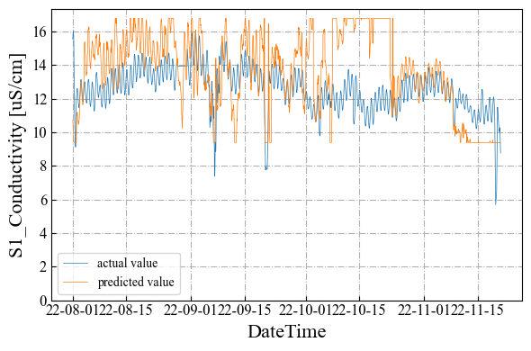
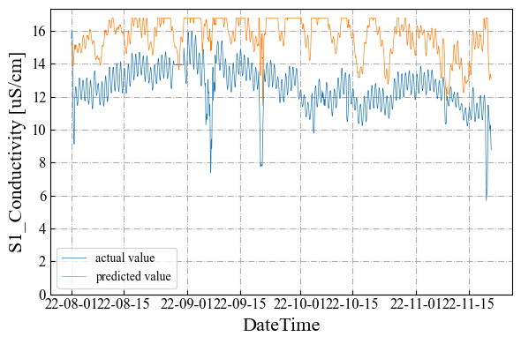
推定値／予測値トレンド
2.2 予測結果 > 1st EC、予測値補正有
推定
RandomForest
予測
推定
LinearTree
予測
推定
線形重回帰
予測
推定
LightGBM
予測
Notes:
There are two steps. First step is RO modeling. In step1, get the operation data from DB and preprocess data. And, build RO model using operation data and setting file. After that, show the model accuracy or prediction trend chart on the dashboard for the operator and save model file to some storage or database. Second step is RO optimization. In step2, get the operation data from DB and preprocess data. And, get the RO model file from storage. Next, calculate optimization using operation data, setting file, and RO model file. After that, show the operation schedule on the dashboard for the operator. To carry out this process, we are looking into the possibility of developing ROCO system at XRAI platform.

Slide 13
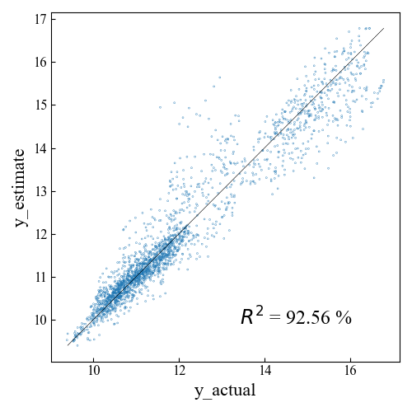
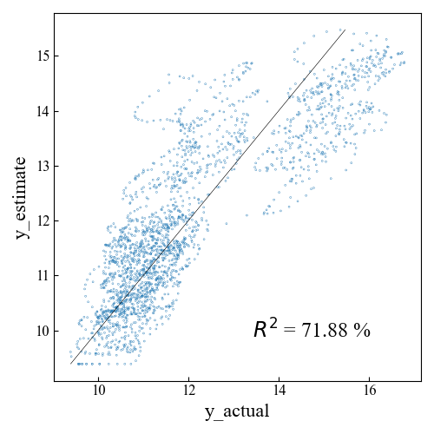
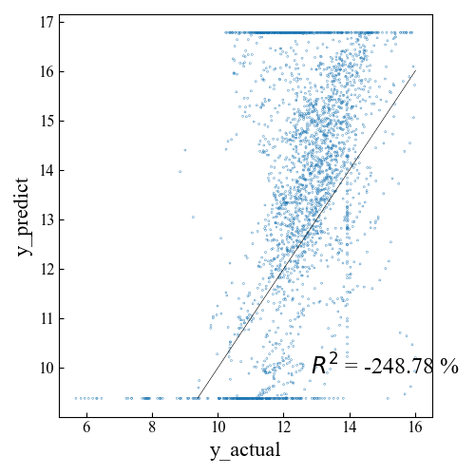
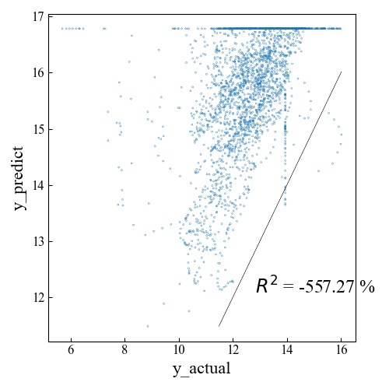
実績値 vs 計算値
2.2 予測結果 > 1st EC、予測値補正有
単位: uS/cm
RandomForest
LinearTree
線形重回帰
LightGBM
実績
vs
推定
データ数2,208個
実績
vs
予測
データ数2,688個
Notes:
There are two steps. First step is RO modeling. In step1, get the operation data from DB and preprocess data. And, build RO model using operation data and setting file. After that, show the model accuracy or prediction trend chart on the dashboard for the operator and save model file to some storage or database. Second step is RO optimization. In step2, get the operation data from DB and preprocess data. And, get the RO model file from storage. Next, calculate optimization using operation data, setting file, and RO model file. After that, show the operation schedule on the dashboard for the operator. To carry out this process, we are looking into the possibility of developing ROCO system at XRAI platform.

Slide 14
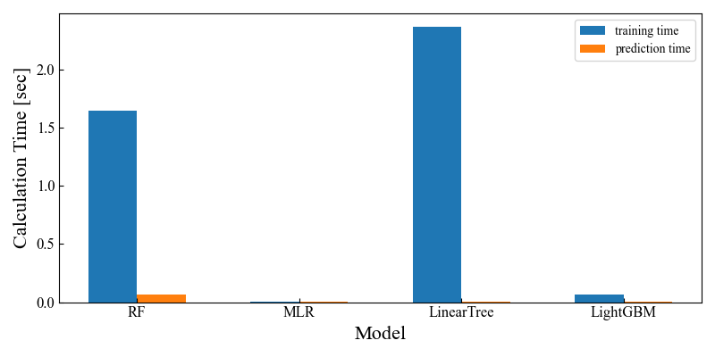
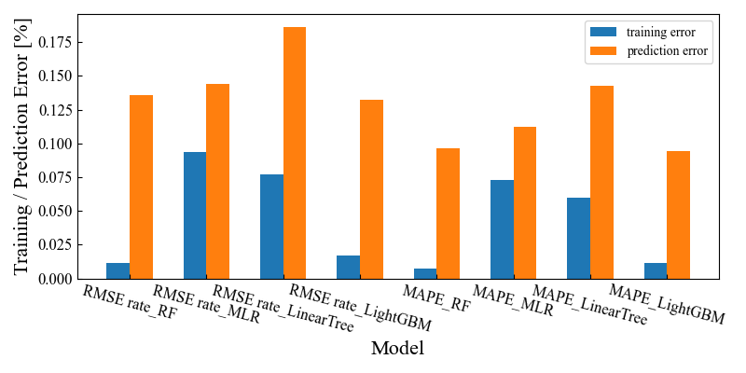
計算時間とモデル精度
2.3 予測結果 > TOC、予測値補正無
LightGBMは、予測時間が短く、汎化性能が良い。
計算時間
モデル精度
1.65秒
2.36秒
0.004秒
0.06秒
0.06秒
0.006秒
0.008秒
0.005秒
学習データ数2,208個／予測データ数2,688個／説明変数9個
Notes:
There are two steps. First step is RO modeling. In step1, get the operation data from DB and preprocess data. And, build RO model using operation data and setting file. After that, show the model accuracy or prediction trend chart on the dashboard for the operator and save model file to some storage or database. Second step is RO optimization. In step2, get the operation data from DB and preprocess data. And, get the RO model file from storage. Next, calculate optimization using operation data, setting file, and RO model file. After that, show the operation schedule on the dashboard for the operator. To carry out this process, we are looking into the possibility of developing ROCO system at XRAI platform.

Slide 15
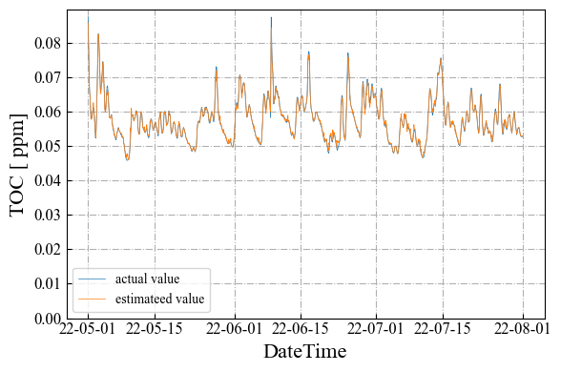
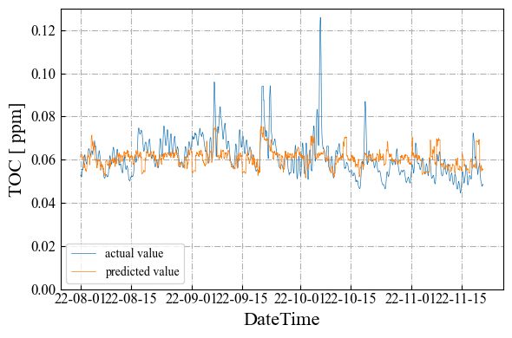
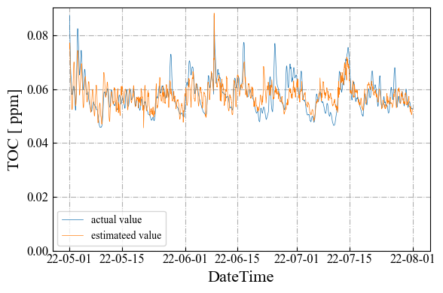
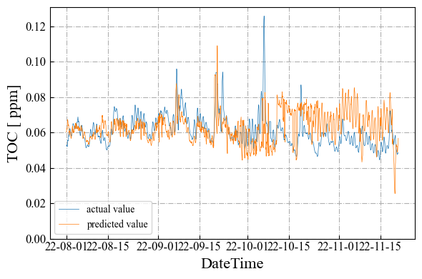
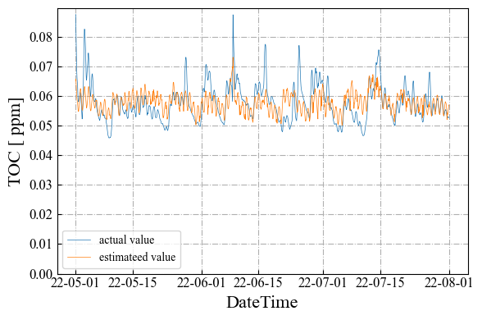
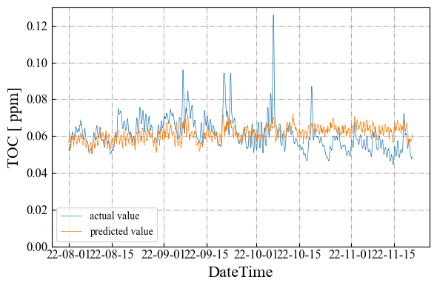
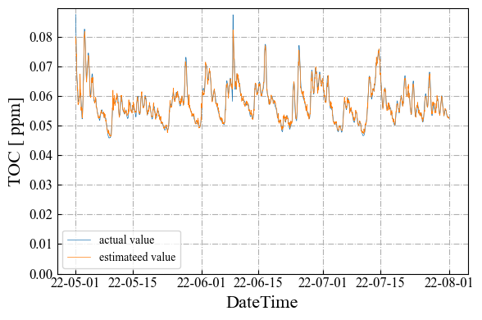
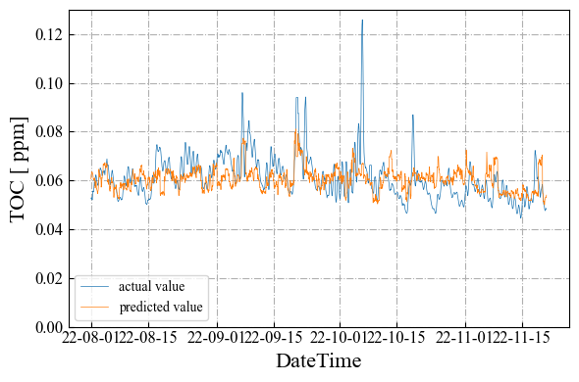
推定値／予測値トレンド
2.3 予測結果 > TOC、予測値補正無
推定
RandomForest
予測
推定
LinearTree
予測
推定
線形重回帰
予測
推定
LightGBM
予測
Notes:
There are two steps. First step is RO modeling. In step1, get the operation data from DB and preprocess data. And, build RO model using operation data and setting file. After that, show the model accuracy or prediction trend chart on the dashboard for the operator and save model file to some storage or database. Second step is RO optimization. In step2, get the operation data from DB and preprocess data. And, get the RO model file from storage. Next, calculate optimization using operation data, setting file, and RO model file. After that, show the operation schedule on the dashboard for the operator. To carry out this process, we are looking into the possibility of developing ROCO system at XRAI platform.

Slide 16
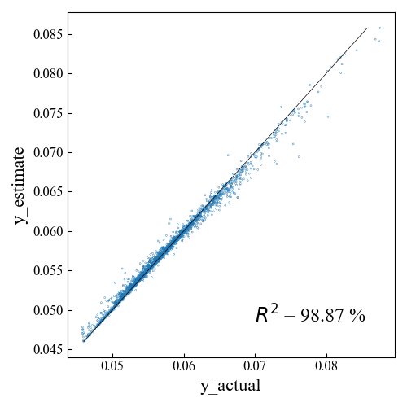
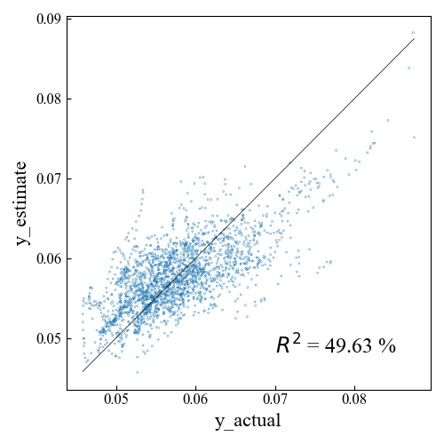
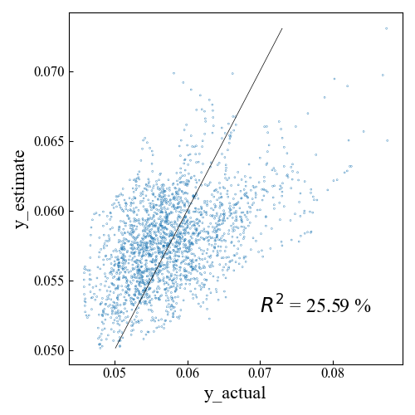
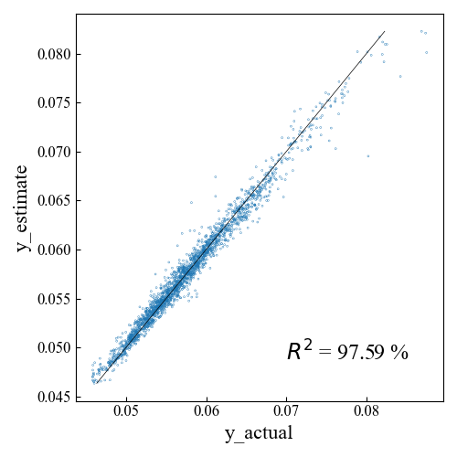
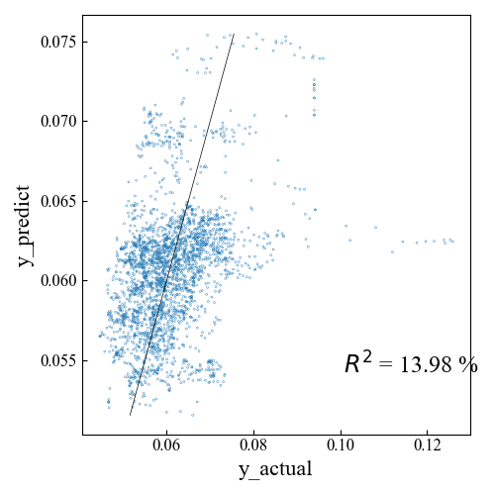
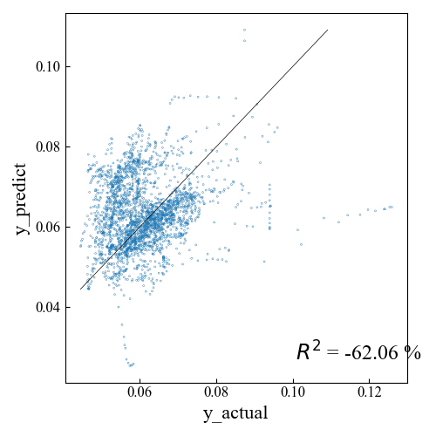
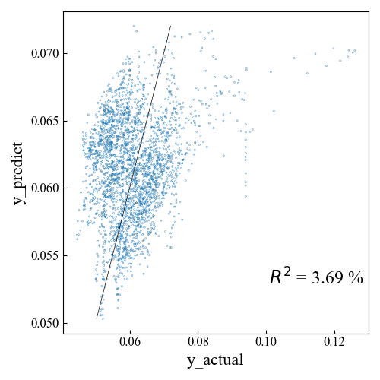
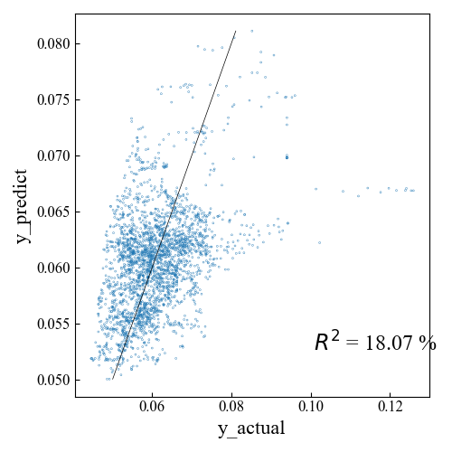
実績値 vs 計算値
2.3 予測結果 > TOC、予測値補正無
単位: ppm
RandomForest
LinearTree
線形重回帰
LightGBM
実績
vs
推定
データ数2,208個
実績
vs
予測
データ数2,688個
Notes:
There are two steps. First step is RO modeling. In step1, get the operation data from DB and preprocess data. And, build RO model using operation data and setting file. After that, show the model accuracy or prediction trend chart on the dashboard for the operator and save model file to some storage or database. Second step is RO optimization. In step2, get the operation data from DB and preprocess data. And, get the RO model file from storage. Next, calculate optimization using operation data, setting file, and RO model file. After that, show the operation schedule on the dashboard for the operator. To carry out this process, we are looking into the possibility of developing ROCO system at XRAI platform.

Slide 17
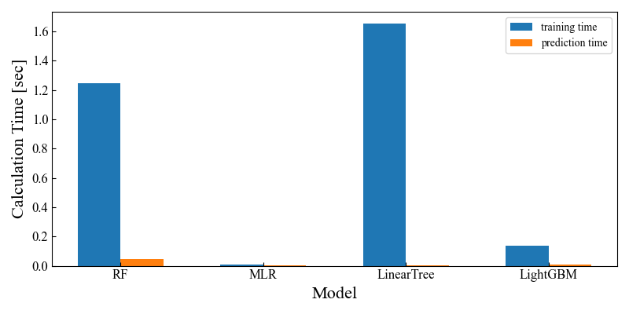

計算時間とモデル精度
2.4 予測結果 > TOC、予測値補正有
LinearTreeだけ予測精度が少しだけ改善するが、傾向は変わらない。
計算時間
モデル精度
1.25秒
1.65秒
0.003秒
0.14秒
0.04秒
0.007秒
0.004秒
0.007秒
学習データ数2,208個／予測データ数2,688個／説明変数9個
Notes:
There are two steps. First step is RO modeling. In step1, get the operation data from DB and preprocess data. And, build RO model using operation data and setting file. After that, show the model accuracy or prediction trend chart on the dashboard for the operator and save model file to some storage or database. Second step is RO optimization. In step2, get the operation data from DB and preprocess data. And, get the RO model file from storage. Next, calculate optimization using operation data, setting file, and RO model file. After that, show the operation schedule on the dashboard for the operator. To carry out this process, we are looking into the possibility of developing ROCO system at XRAI platform.

Slide 18
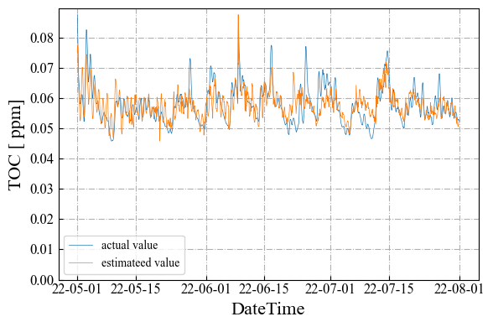

推定値／予測値トレンド
2.4 予測結果 > TOC、予測値補正有
推定
RandomForest
予測
推定
LinearTree
予測
推定
線形重回帰
予測
推定
LightGBM
予測
Notes:
There are two steps. First step is RO modeling. In step1, get the operation data from DB and preprocess data. And, build RO model using operation data and setting file. After that, show the model accuracy or prediction trend chart on the dashboard for the operator and save model file to some storage or database. Second step is RO optimization. In step2, get the operation data from DB and preprocess data. And, get the RO model file from storage. Next, calculate optimization using operation data, setting file, and RO model file. After that, show the operation schedule on the dashboard for the operator. To carry out this process, we are looking into the possibility of developing ROCO system at XRAI platform.

Slide 19

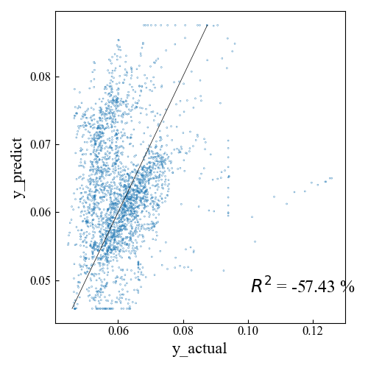
実績値 vs 計算値
2.4 予測結果 > TOC、予測値補正有
単位: ppm
RandomForest
LinearTree
線形重回帰
LightGBM
実績
vs
推定
データ数2,208個
実績
vs
予測
データ数2,688個
Notes:
There are two steps. First step is RO modeling. In step1, get the operation data from DB and preprocess data. And, build RO model using operation data and setting file. After that, show the model accuracy or prediction trend chart on the dashboard for the operator and save model file to some storage or database. Second step is RO optimization. In step2, get the operation data from DB and preprocess data. And, get the RO model file from storage. Next, calculate optimization using operation data, setting file, and RO model file. After that, show the operation schedule on the dashboard for the operator. To carry out this process, we are looking into the possibility of developing ROCO system at XRAI platform.

Slide 20
総合結果
2.4 予測結果
計算時間と性能が優れているのはLightGBM
赤：1位、青：2位
1st EC
TOC
区分 | 指標 | RF | MLR | LinearTree | LightGBM
Training | Time[sec] | 0.79 | 0.02 | 1.15 | 0.08
 | RMSE rate[%] | 0.71 | 7.89 | 4.05 | 0.91
 | MAPE[%] | 0.43 | 6.06 | 2.59 | 0.67
 | R^2[%] | 99.8 | 71.9 | 92.5 | 99.6
Predict | Time[sec] | 0.03 | 0.002 | 0.004 | 0.004
 | RMSE rate[%] | 16.6 | 27.7 | 23.8 | 16.7
 | MAPE[%] | 14.1 | 26.9 | 18.1 | 14.1
 | R^2[%] | -161 | -627 | -436 | -164
区分 | 指標 | RF | MLR | LinearTree | LightGBM
Training | Time[sec] | 1.65 | 0.006 | 2.36 | 0.06
 | RMSE rate[%] | 1.15 | 9.38 | 7.72 | 1.69
 | MAPE[%] | 0.69 | 7.29 | 5.96 | 1.15
 | R^2[%] | 98.9 | 25.6 | 49.6 | 97.6
Predict | Time[sec] | 0.06 | 0.004 | 0.008 | 0.005
 | RMSE rate[%] | 13.6 | 14.4 | 18.7 | 13.3
 | MAPE[%] | 9.65 | 11.2 | 14.3 | 9.43
 | R^2[%] | 14.0 | 3.69 | -62.1 | 18.1
補正機能無し
区分 | 指標 | RF | MLR | LinearTree | LightGBM
Training | Time[sec] | 0.87 | 0.008 | 1.45 | 0.06
 | RMSE rate[%] | 0.71 | 7.88 | 4.05 | 0.91
 | MAPE[%] | 0.43 | 6.04 | 2.59 | 0.67
 | R^2[%] | 99.8 | 71.9 | 92.6 | 99.6
Predict | Time[sec] | 0.04 | 0.002 | 0.004 | 0.003
 | RMSE rate[%] | 16.6 | 26.4 | 19.2 | 16.7
 | MAPE[%] | 14.1 | 26.9 | 18.1 | 14.1
 | R^2[%] | -161 | -557 | -249 | -164
区分 | 指標 | RF | MLR | LinearTree | LightGBM
Training | Time[sec] | 1.25 | 0.007 | 1.65 | 0.14
 | RMSE rate[%] | 1.15 | 9.38 | 7.72 | 1.69
 | MAPE[%] | 0.70 | 7.29 | 5.96 | 1.15
 | R^2[%] | 98.9 | 25.6 | 49.6 | 97.6
Predict | Time[sec] | 0.04 | 0.003 | 0.004 | 0.007
 | RMSE rate[%] | 13.6 | 14.4 | 18.4 | 13.3
 | MAPE[%] | 9.65 | 11.2 | 14.1 | 9.43
 | R^2[%] | 14.0 | 3.69 | -57.4 | 18.1
補正機能有り
Notes:
There are two steps. First step is RO modeling. In step1, get the operation data from DB and preprocess data. And, build RO model using operation data and setting file. After that, show the model accuracy or prediction trend chart on the dashboard for the operator and save model file to some storage or database. Second step is RO optimization. In step2, get the operation data from DB and preprocess data. And, get the RO model file from storage. Next, calculate optimization using operation data, setting file, and RO model file. After that, show the operation schedule on the dashboard for the operator. To carry out this process, we are looking into the possibility of developing ROCO system at XRAI platform.

Slide 21
最適化計算への影響
2.5 最適化計算
簡潔に計算を試した。余裕があるときに1か月最適化を試す予定。
50回同士を比較すると、1.4倍に留まるため、この辺のデータ数の増加はそこまで影響しない
学習期間 | 最適化期間 | モデル | 反復回数 | 最適化計算時間
1週間 | 1週間 | 重回帰 | 5,000 | 10min
1週間 | 1週間 | RF | 5,000 | 6,200min = 103hour
1週間 | 1週間 | LightGBM | 50 | 4.88min = 0.081hour
1週間 | 1週間 | LightGBM | 500 | 50.5min
1週間 | 1週間 | LightGBM | 5,000 | 8.1hour
1か月 | 1か月 | LightGBM | 50 | 6.6min = 0.11hour
1か月 | 1か月 | LightGBM | 500 | 52.8min
1か月 | 1か月 | LightGBM | 5,000 | 11hour
見込
実行不可能解、100KB
実行可能解
見込
実行不可能解
実行不可能解
見込
SHADE + Feasibility Ruleで実行した場合
Notes:
There are two steps. First step is RO modeling. In step1, get the operation data from DB and preprocess data. And, build RO model using operation data and setting file. After that, show the model accuracy or prediction trend chart on the dashboard for the operator and save model file to some storage or database. Second step is RO optimization. In step2, get the operation data from DB and preprocess data. And, get the RO model file from storage. Next, calculate optimization using operation data, setting file, and RO model file. After that, show the operation schedule on the dashboard for the operator. To carry out this process, we are looking into the possibility of developing ROCO system at XRAI platform.

Slide 22
まとめ
3. まとめ
OCWDデータでも、回帰木ベースの手法を比較し、計算時間とモデル精度の観点から、 LightGBMが有力であることを確認した。
LightGBM：RandomForestよりも軽く、汎化性能も期待できる
今後
1か月最適化を試して、計測する。
各モデルのハイパラ調整を行う。
ハイパラの公平性も課題として残っているため、ハイパラ調整アルゴリズムを適用するのが考えられる。
データ数の変化（1週間～1か月）よりもモデルの複雑性が計算時間に影響を与えるため、ハイパラ（木の数など）を調整して時間削減する方向も考えられる。
複雑すぎるハイパラを除外した範囲内で、ハイパラ調整するのが妥当か？
Notes:
There are two steps. First step is RO modeling. In step1, get the operation data from DB and preprocess data. And, build RO model using operation data and setting file. After that, show the model accuracy or prediction trend chart on the dashboard for the operator and save model file to some storage or database. Second step is RO optimization. In step2, get the operation data from DB and preprocess data. And, get the RO model file from storage. Next, calculate optimization using operation data, setting file, and RO model file. After that, show the operation schedule on the dashboard for the operator. To carry out this process, we are looking into the possibility of developing ROCO system at XRAI platform.

Slide 24
重回帰とRandom Forest
1. 最適化方法
Random Forestによる水質予測モデルを最適化で使用する場合、 重回帰の300倍の計算時間を要すると見積もられる。
長期予測では、比較的複雑な機械学習モデルが望ましいと予想される
# | Modeling | Optimization | 最適化計算時間
1 | 線形重回帰 | メタ＋制約対処法 | 約10min
2 | Random Forest | メタ＋制約対処法 | 約6,200min（103hour, 見込）
計算量が多いモデルを最適化で使用する場合、計算リソースを増やすか、削減するテクニックが必要。
社内業務用ノートPC（Intel Core i5-1145G7(2.60GHz)、内蔵GPU 11th Gen）
Notes:
There are two steps. First step is RO modeling. In step1, get the operation data from DB and preprocess data. And, build RO model using operation data and setting file. After that, show the model accuracy or prediction trend chart on the dashboard for the operator and save model file to some storage or database. Second step is RO optimization. In step2, get the operation data from DB and preprocess data. And, get the RO model file from storage. Next, calculate optimization using operation data, setting file, and RO model file. After that, show the operation schedule on the dashboard for the operator. To carry out this process, we are looking into the possibility of developing ROCO system at XRAI platform.

Slide 25
Task2実証の目的
3. まとめ
目的1：データ収集・モデリング検証のための実験
最適化検証用モデルのためのデータ収集
取得したデータを用いたモデル検証
目的2：最適化検証のための実証実験
オンラインで最適操業計画を実施してもらい、最適化効果を検証する
Notes:
RO optimization problem~. The procedure~. First step is drawing flow chart. In this chart, arrows connecting objects are assigned optimization variables. The object plays the role of exogenous variable, mathematical model, and predictive variable. Second step is formulation optimization problem. I define the minimizing the objective function and the constraints. Third step is calculation operational schedule. I solve the formulated problem using optimization algorithm.

Slide 26
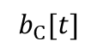
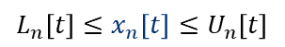



















Plant Scheduling Optimization
1. RO Optimization Simulation
1. Drawing Flow Chart
2. Formulation
Optimization Problem
3. Calculation
Operational Schedule
RO optimization problem is formulated into a scheduling optimization.
The procedure consists of the following steps.
Sample Flow Chart
$$minimize$$
$$f(x)$$
(Operational Cost)
$$subj.to$$
$$x_{1}$$
$$x_{1}[t]$$
A
$$x_{3}[t]$$
$$L_{n}\left[t\right]≤x_{n}\left[t\right]≤U_{n}\left[t\right]$$
$$x_{5}[t]$$
C
$$b_{C}[t]$$
$$\left|x_{n}\left[t\right]−x_{n}\left[t−1\right]\right|≤∆_{n}$$
$$x_{2}$$
B
$$x_{4}[t]$$
$$x_{2}[t]$$
$$g_{A}[t]≤0$$
$$g_{B}[t]≤0$$
(Facility Characteristics)
$$1$$
Time $t$
$$L$$
Facility Model
$x$: Optimization Variable
$$g_{C}[t]≤0$$
Operational Cost is $XX.
Notes:
RO optimization problem~. The procedure~. First step is drawing flow chart. In this chart, arrows connecting objects are assigned optimization variables. The object plays the role of exogenous variable, mathematical model, and predictive variable. Second step is formulation optimization problem. I define the minimizing the objective function and the constraints. Third step is calculation operational schedule. I solve the formulated problem using optimization algorithm.

Slide 27
[LVMWD] RO System Configuration and Measurement Points
・Feed Free Chlorine
・Feed Conductivity
・Feed pH, TOC, Temp
・Feed Pressure
・Feed Flow (Calc)
・Inlet Free Chlorine
・Inlet Total Chlorine
・Inlet pH
・Inlet UVT
・Inlet Flow
・Outlet Free Chlorine
・Outlet Total Chlorine
・Inlet UVT
a
・Permeate Flow
・Permeate Conductivity
・Combined Permeate TOC
・Combined Permeate Conductivity
RO 1st Stage
UV
P
This pump decides the feed flow to RO.
Feed Pressure
b
・Permeate Flow
・Permeate Conductivity
RO 2nd Stage
・UV Dose
・UV Intensity
・UV Lamp Power (Constant 50%)
d
・Permeate Flow
・Permeate Conductivity
c
Feed Pressure
Concentrate Pressure
RO 3rd Stage
P
<Differential Pressure>
Stage 1 = －
Stage 2 = －
Stage 3 = －
a
b
e
b
c
・Concentrate Pressure
・Concentrate Flow
d
e

Slide 28


[OCWD] RO Feed and Permeate System Configuration
Conductivity, TOC
XACT920 (Si, P, S, K, Ca, Fe, Sr, TDS)
RO Feed
RO Unit System
Sulfuric Acid
Anti-Scalant Addition
ROP
…
MF Break Tank
P
Cartridge Filters
P
RO Transfer Pump Station
RO Feed Pump
TOC, Ammonia, pH, Turbidity, Conductivity,
Total Chlorine, Free Chlorine
XACT920 (Si, P, S, K, Ca, Fe, Sr, TDS)
Concentrate

Slide 29


[OCWD] RO Unit B01 System Configuration
FW Press
Blank 1 Perm Flow,
Blank 1 Perm Cond
Perm Press
RO Feed
P
1st
RO Feed Pump
Blank 2 Perm Flow,
Blank 2 Perm Cond
Blank 2-3 Perm Flow
Perm Flow,
Perm Cond
FW B1 DP
CONC B1 Press
FW B2 Press
ROP
P
2nd
Booster Pump
Blank 3 Perm Flow,
Blank 3 Perm Cond
Membrane Press
FW B23 DP
FW B2 DP
FW B3 Press
3rd
Flow
Pressure
Conductivity
Differential Pressure
FW B3 DP
CONC Press
Conc Cond, Conc Flow
Concentrate
29

Slide 30
条件
1. 最適化シミュレーション
最適化期間（30分間隔データ、1週間：337steps）
LVMWD：2022/03/14 0:00 – 2022/03/20 0:00
OCWD：2022/05/20 0:00 – 2022/05/27 0:00
水質予測モデルの学習期間直後の1週間
アルゴリズム
SHADE + Feasibility Rule
反復回数/世代数：500
個体数：100

Slide 31




























決定木 Decision Tree（回帰木 Regression Tree）
1. 最適化方法 > 予測手法
データ空間を区分して作られる階段状のモデル。
$$y=3.5$$
$$x>1$$
$$x≤1$$
数理モデル
$$y=f(x)$$
ツリー構造
$$y=2$$
$$y=5$$
$$x>2$$
$$2≥x$$
一般の数理モデル
非定数関数の合成
$$y=4$$
$$y=1$$
$$y=w_{2}x_{2}+w_{1}x_{1}$$
$$x≥3$$
$$3<x$$
重回帰：
$$y=6$$
$$y=3$$
$$y=\frac{1}{1+\exp{(−w_{2}x_{2}−w_{1}x_{1})}}$$
ロジスティック回帰：
（分類向け）
データ空間
$$6$$
ニューラルネットワーク：
$$y=tanh⁡(w_{2}x_{2}+w_{1}x_{1})$$
$$5$$
2変数以上の空間
回帰木モデル
If-Thenルールの合成
$$y$$
$$3$$
$$y=\left\{\begin{matrix}5; x≤1 \\ 1; 1<x≤2 \\ \begin{matrix}6; 2<x≤3 \\ 3; 3<x\end{matrix}\end{matrix}\right.$$
$$1$$
$$1$$
$$2$$
$$3$$
$$x$$
Notes:
There are two steps. First step is RO modeling. In step1, get the operation data from DB and preprocess data. And, build RO model using operation data and setting file. After that, show the model accuracy or prediction trend chart on the dashboard for the operator and save model file to some storage or database. Second step is RO optimization. In step2, get the operation data from DB and preprocess data. And, get the RO model file from storage. Next, calculate optimization using operation data, setting file, and RO model file. After that, show the operation schedule on the dashboard for the operator. To carry out this process, we are looking into the possibility of developing ROCO system at XRAI platform.

Slide 32


回帰木モデルの分類
1. 最適化方法 > 予測手法
アンサンブル学習とモデルツリーが有力と考えられる。
回帰木モデル
古典的な回帰木
アンサンブル学習
モデルツリー
各ノードを定数関数とした木を弱学習器とする
各ノードを非定数関数とした、区分モデルを構築
Bootstrap Aggregating
勾配ブースティング
CART
RandomForest
LightGBM
LinearTree
Submodel=MLR
過学習しやすい
オープンソース/MIT License
https://github.com/cerlymarco/linear-tree
オープンソース/MIT License
Notes:
There are two steps. First step is RO modeling. In step1, get the operation data from DB and preprocess data. And, build RO model using operation data and setting file. After that, show the model accuracy or prediction trend chart on the dashboard for the operator and save model file to some storage or database. Second step is RO optimization. In step2, get the operation data from DB and preprocess data. And, get the RO model file from storage. Next, calculate optimization using operation data, setting file, and RO model file. After that, show the operation schedule on the dashboard for the operator. To carry out this process, we are looking into the possibility of developing ROCO system at XRAI platform.

Slide 33

計算量オーダー
1. 最適化方法 > 予測手法
MLR、Linear Tree、LightGBMが有力と考えられる。
手法 | 学習の計算量 | 予測の計算量
MLR | $$𝒪(M^{3})$$ | $$𝒪(M×N_{pre})$$
LinearTree | $$𝒪(N\log{N})$$ | $未調査$（CARTと同様？）
RandomForest | $T,N,S$に依存（最も多いと予想される） | $𝒪(T×N_{pre})$（最も多い）
LightGBM | Histogram based Algorithm（インスタンス数削減） Exclusive Feature Bundling: $𝒪\left(B×Bin\right)$ Gradient-based One-Side Sampling:$𝒪\left(M×L\right)$ | 未調査（RFと同様だが、最終的な木構造がコンパクトになる？）
※共通パラメータ：学習データ数$N$、説明変数の数$M$、計画データ数$N_{pre}$
※RFのパラメータ：木の数$T$、単位領域当たりの最小サンプル数$S$
※LightGBMのパラメータ：GOSSで採択するサンプル数$L≪N$、バンドル数$B≪M$、ビン数$Bin≪N$
Notes:
There are two steps. First step is RO modeling. In step1, get the operation data from DB and preprocess data. And, build RO model using operation data and setting file. After that, show the model accuracy or prediction trend chart on the dashboard for the operator and save model file to some storage or database. Second step is RO optimization. In step2, get the operation data from DB and preprocess data. And, get the RO model file from storage. Next, calculate optimization using operation data, setting file, and RO model file. After that, show the operation schedule on the dashboard for the operator. To carry out this process, we are looking into the possibility of developing ROCO system at XRAI platform.

Slide 34
LightGBM
2-1. 非線型最適化結果
回帰木モデルを弱学習器としたアンサンブル学習を用いる。
Bootstrap Aggregating（バギング）
勾配ブースティング
過学習を緩和
未学習を緩和
学習データからランダムに抽出し、複数の木で学習し、それらの予測結果を平均する
予測モデルの間違った予測に焦点を当て、重みを加味して次のモデルを改善する
（前の弱学習器の誤差を学習）
Random Forest
XGBoost
Light GBM（Microsoft, 2016）
Kaggleなどで多用される
特徴量をヒストグラム化することで、計算コストを抑制
（XGBoostよりも学習時間が短い）
https://www.codexa.net/lightgbm-beginner/

Slide 35






区分線形（Piecewise LinearRegression）
2-1. 非線型最適化結果
PARC
LinearTree
LinearTreeと類似するが、下記点で異なる。
分割数（num_breakpoints）を指定する必要がある
境界線の連続性を維持する
真の関数
https://github.com/bemporad/PyPARC

Slide 36

予測値補正機能
2.2 ベンチマークデータ検証結果（補正機能）
学習データの範囲を学習しておいて、外れた予測値を強制的に補正する。
つまり、学習範囲外では定数として出力する
学習時
予測時
補正
学習データ
目的変数y
予測データ
[0, 5]
予測モデル
説明変数x
予測モデル
傾向を学習
補正
予測値
補正対象
データ端では定数に補正するため、外れ値の
予測精度悪化を抑制
予測値補正機能
予測値補正機能
範囲を学習
補正済予測値
実績の範囲[0, 5]
Notes:
There are two steps. First step is RO modeling. In step1, get the operation data from DB and preprocess data. And, build RO model using operation data and setting file. After that, show the model accuracy or prediction trend chart on the dashboard for the operator and save model file to some storage or database. Second step is RO optimization. In step2, get the operation data from DB and preprocess data. And, get the RO model file from storage. Next, calculate optimization using operation data, setting file, and RO model file. After that, show the operation schedule on the dashboard for the operator. To carry out this process, we are looking into the possibility of developing ROCO system at XRAI platform.

Slide 37
②の課題（機能要件／非機能要件）
3. まとめ
1分データの前処理
ノイズ除去するための処理（スムージングなど、プラント・データ特有の処理も含む）
学習に失敗しないための処理（定数・欠損の対応など）
期間、データ刻み、モデル更新、最適化計算の頻度
予測・最適化のステップ（時間刻み）と将来期間
モデル更新頻度（条件付きで更新するやり方もある）
最適化計算結果の更新頻度
最適化計算に失敗した場合の処理
前回の最適化結果の末尾の値を定数として採用するなど
エラー処理・エラーコードの追加
長期予測・最適化計算のためのモデル（Random Forestよりも計算時間少ない？）
熊谷がやるのがベスト？
Notes:
RO optimization problem~. The procedure~. First step is drawing flow chart. In this chart, arrows connecting objects are assigned optimization variables. The object plays the role of exogenous variable, mathematical model, and predictive variable. Second step is formulation optimization problem. I define the minimizing the objective function and the constraints. Third step is calculation operational schedule. I solve the formulated problem using optimization algorithm.

